Slide 1
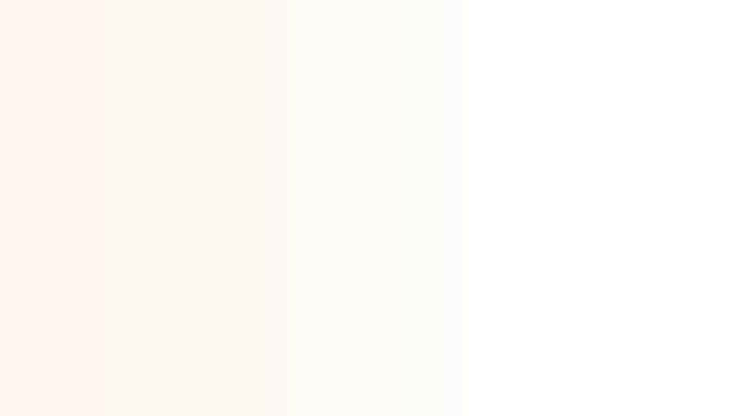

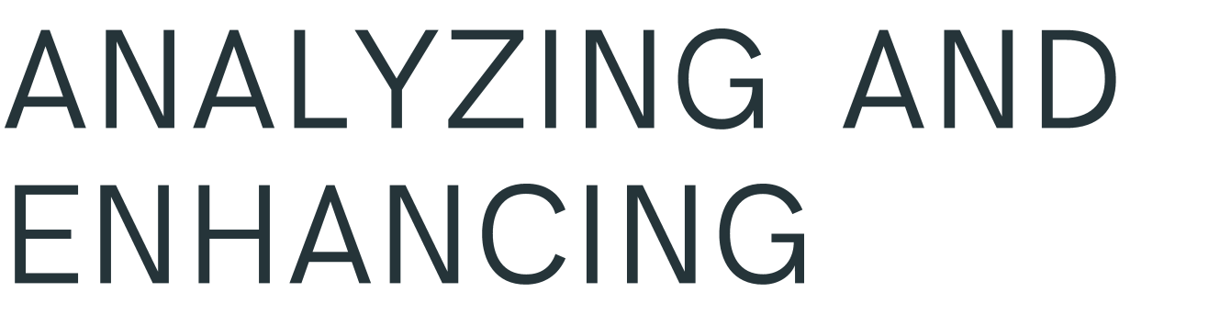



by Ram Prakash CH [ S 1 9 0 1 6 7 ] ,
Siva Kumar Red dy K [ S 1 9 0 7 0 2 ] , Deep th i CH [ S 1 9 0 2 1 8]

Slide 2


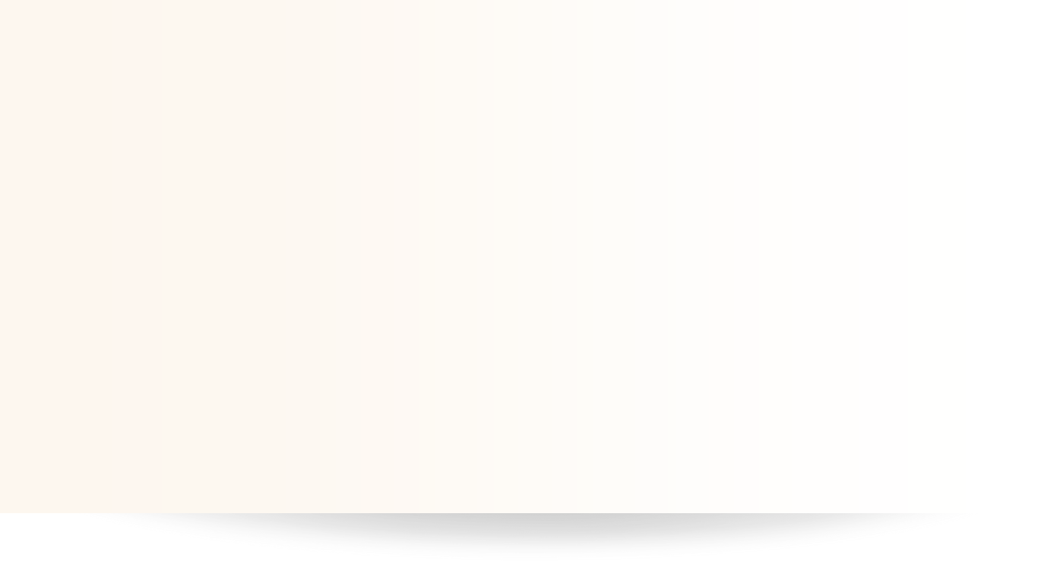

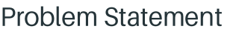
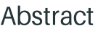
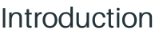

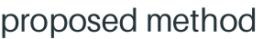

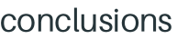

•
•
•
•
•
•
•
•

Slide 3
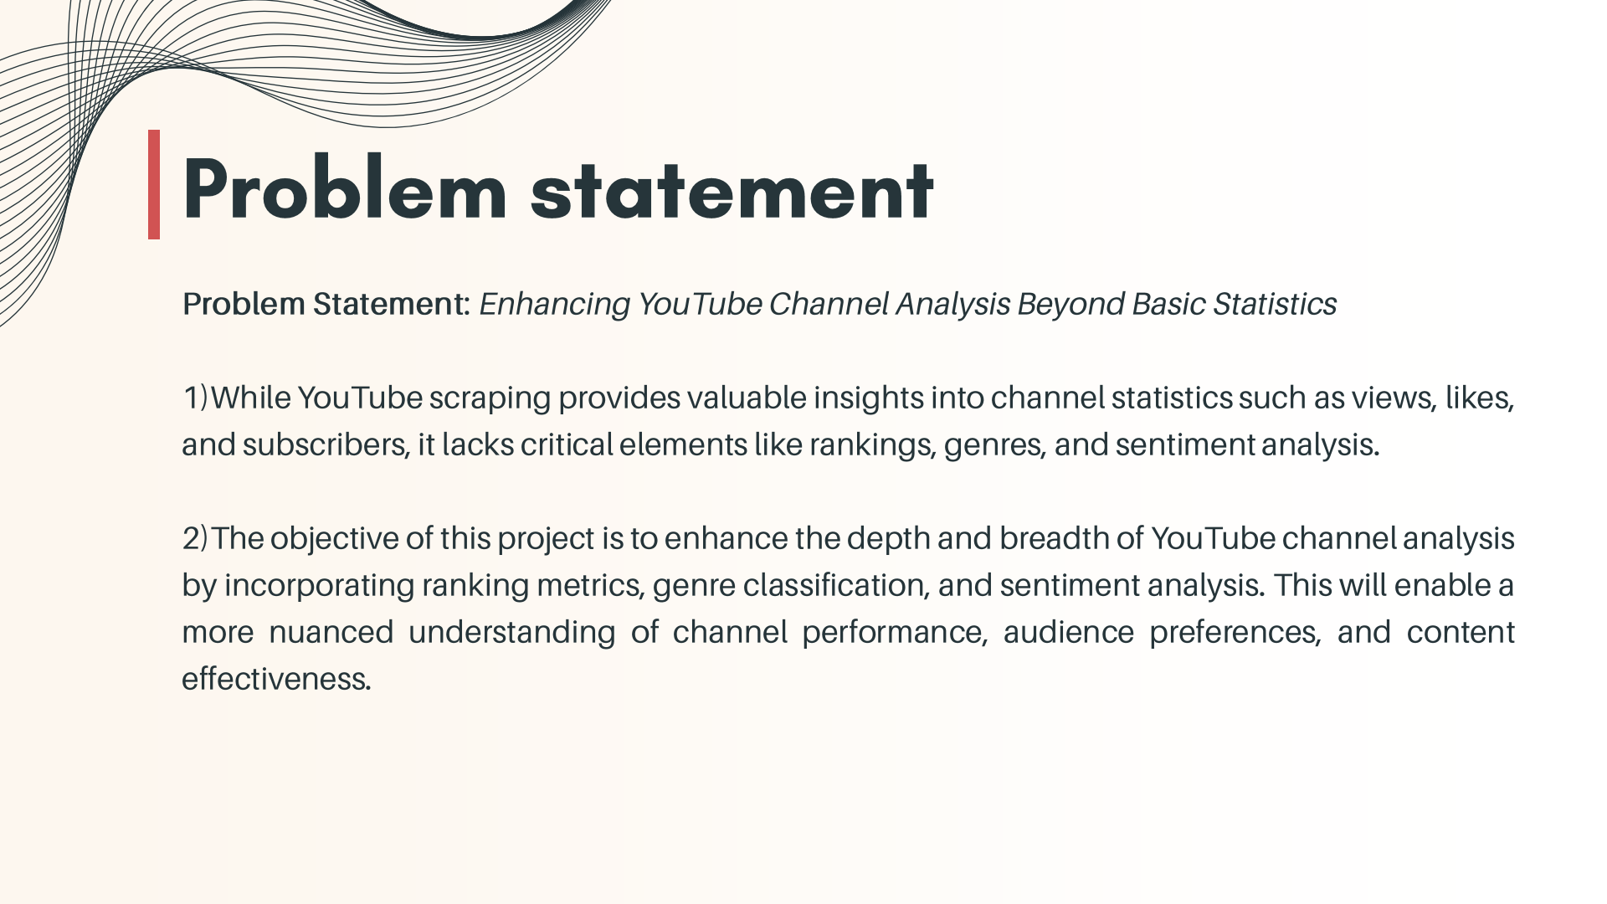

Slide 4
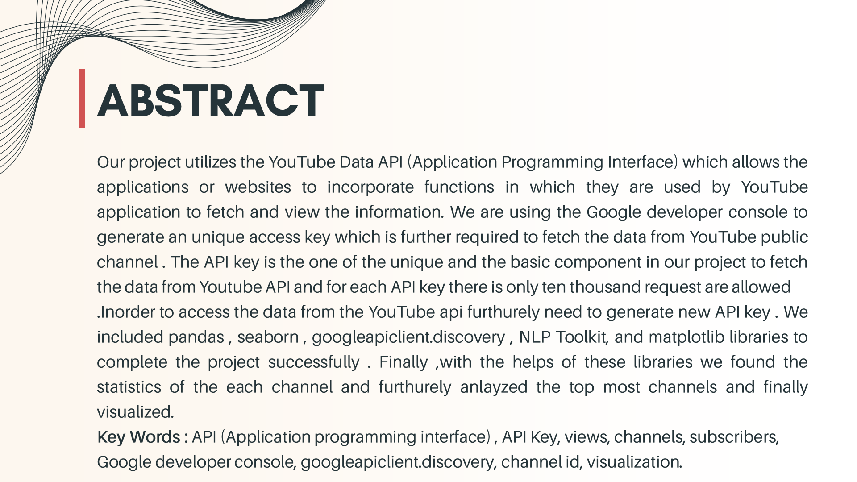

Slide 5








1)MOTIVATION FOR THE WORK
:

Slide 6


2)REAL WORLD APPLICATIONS:
A) YouTube Recommendation System
B)Opinion Mining

Slide 7
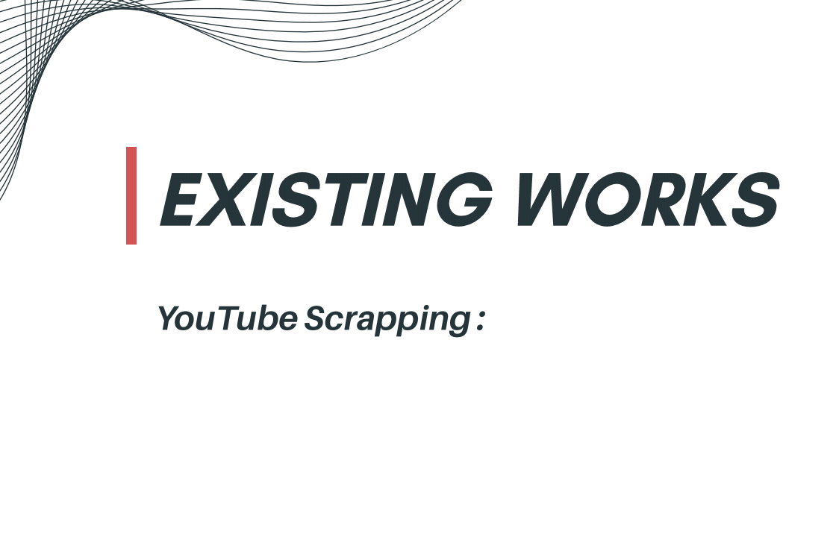

Allows you to crawl YouTube search results and extract data such as video hashtags,
titles, descriptions, video ID, channel ID, the number of views, etc.
YouTube scrapping is extracting the statistics of the channels but not assigning
the rankings, genres and sentimental analysis to the channels .

Slide 8
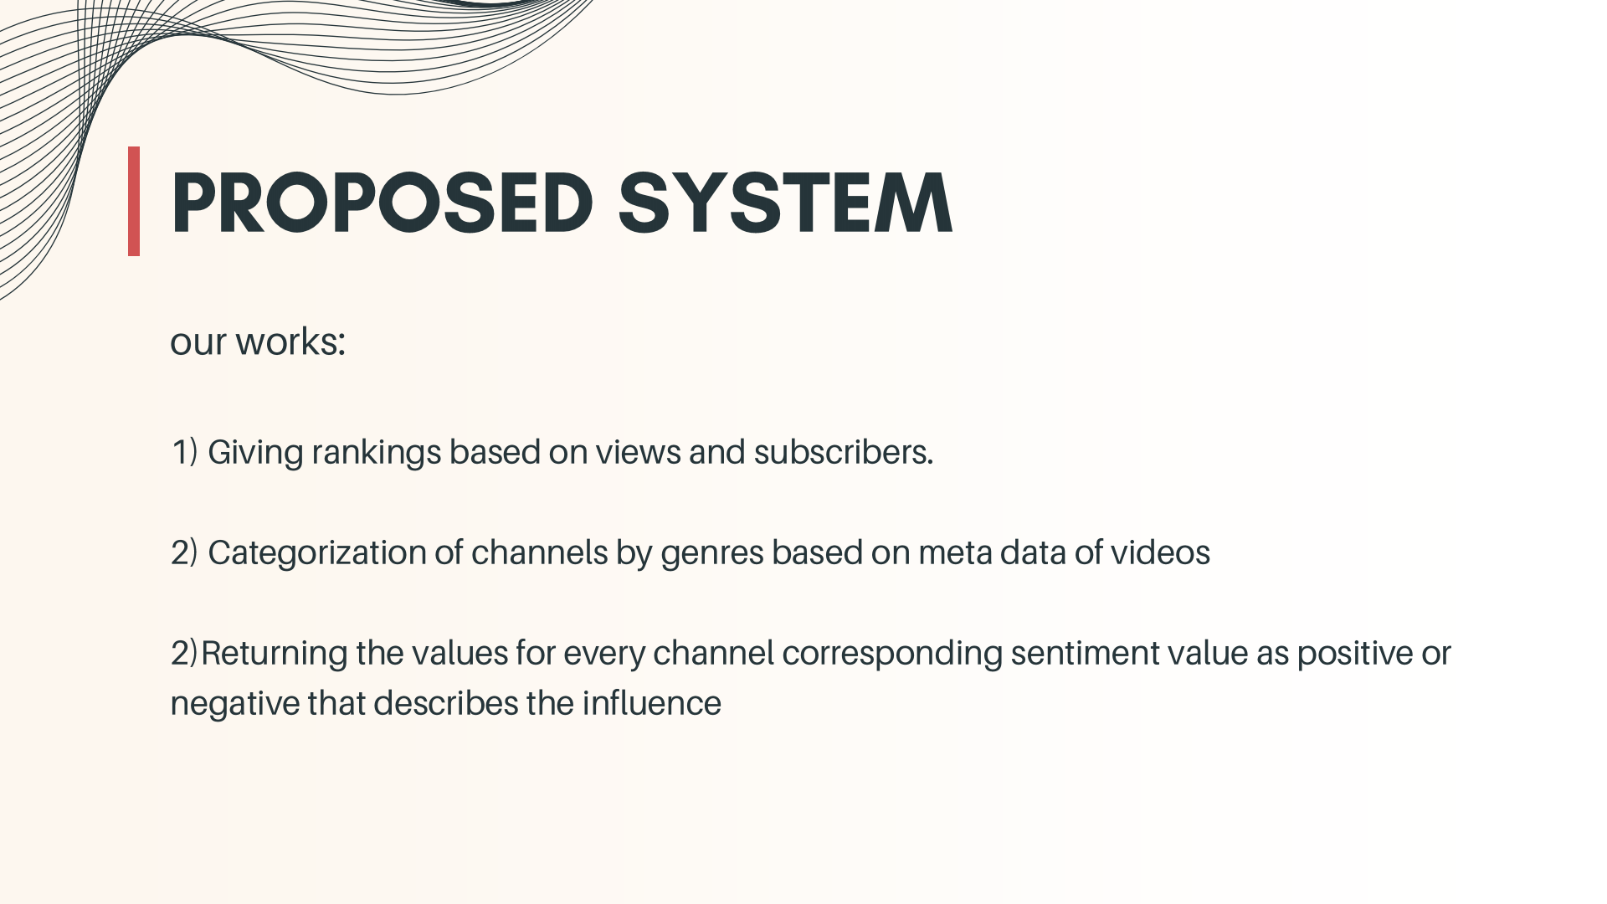

Slide 9


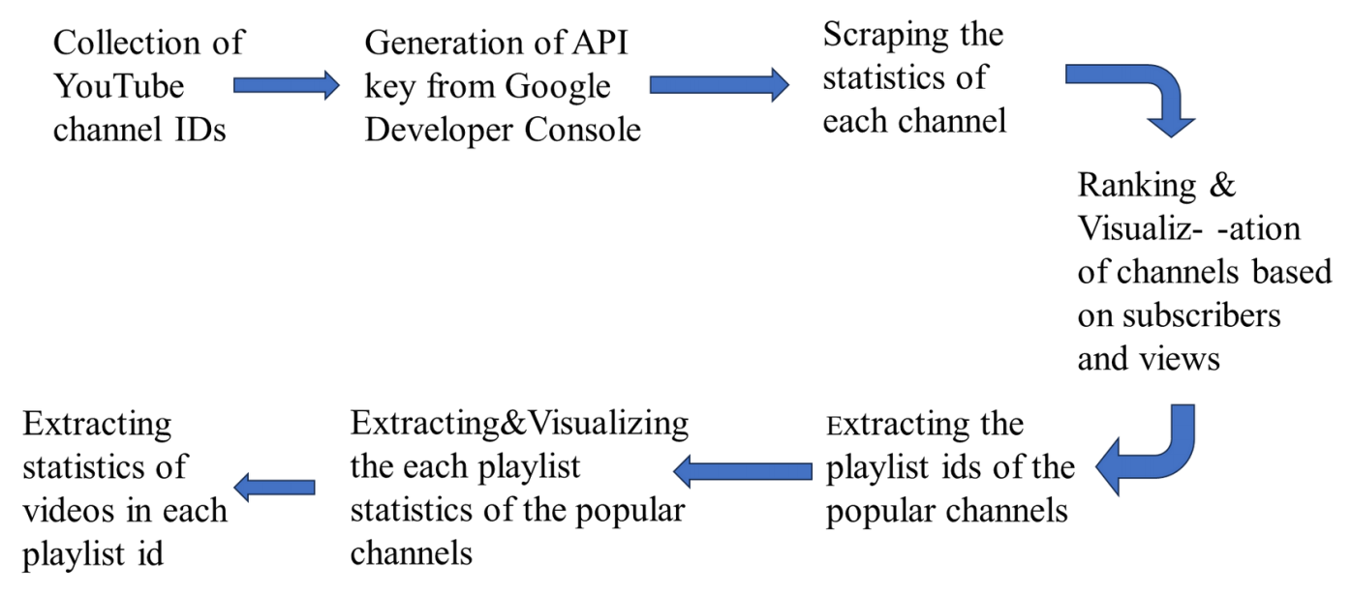
Sentimental
analysis on
comments to
find positive or
negative
influence
Categorization
of channels in
to genres
using metadata

Slide 10
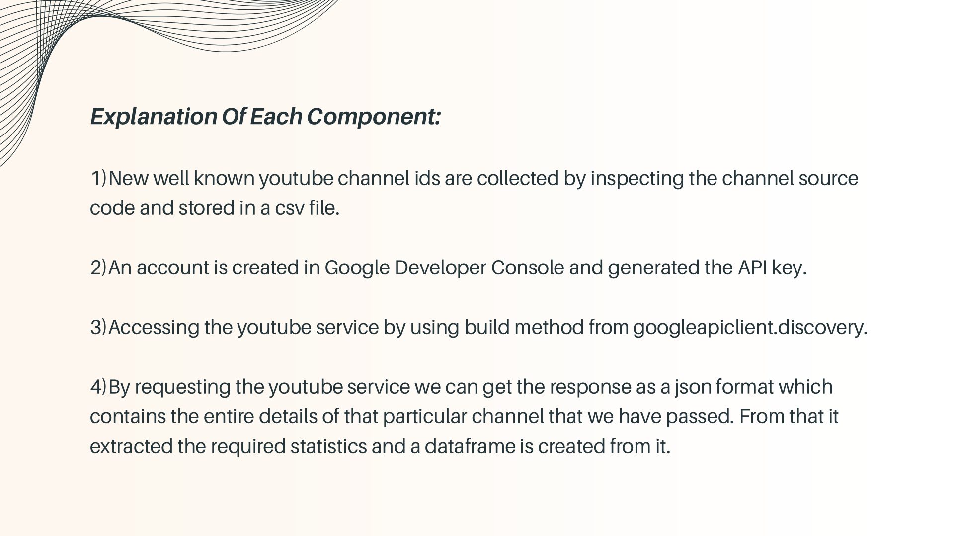

Slide 11
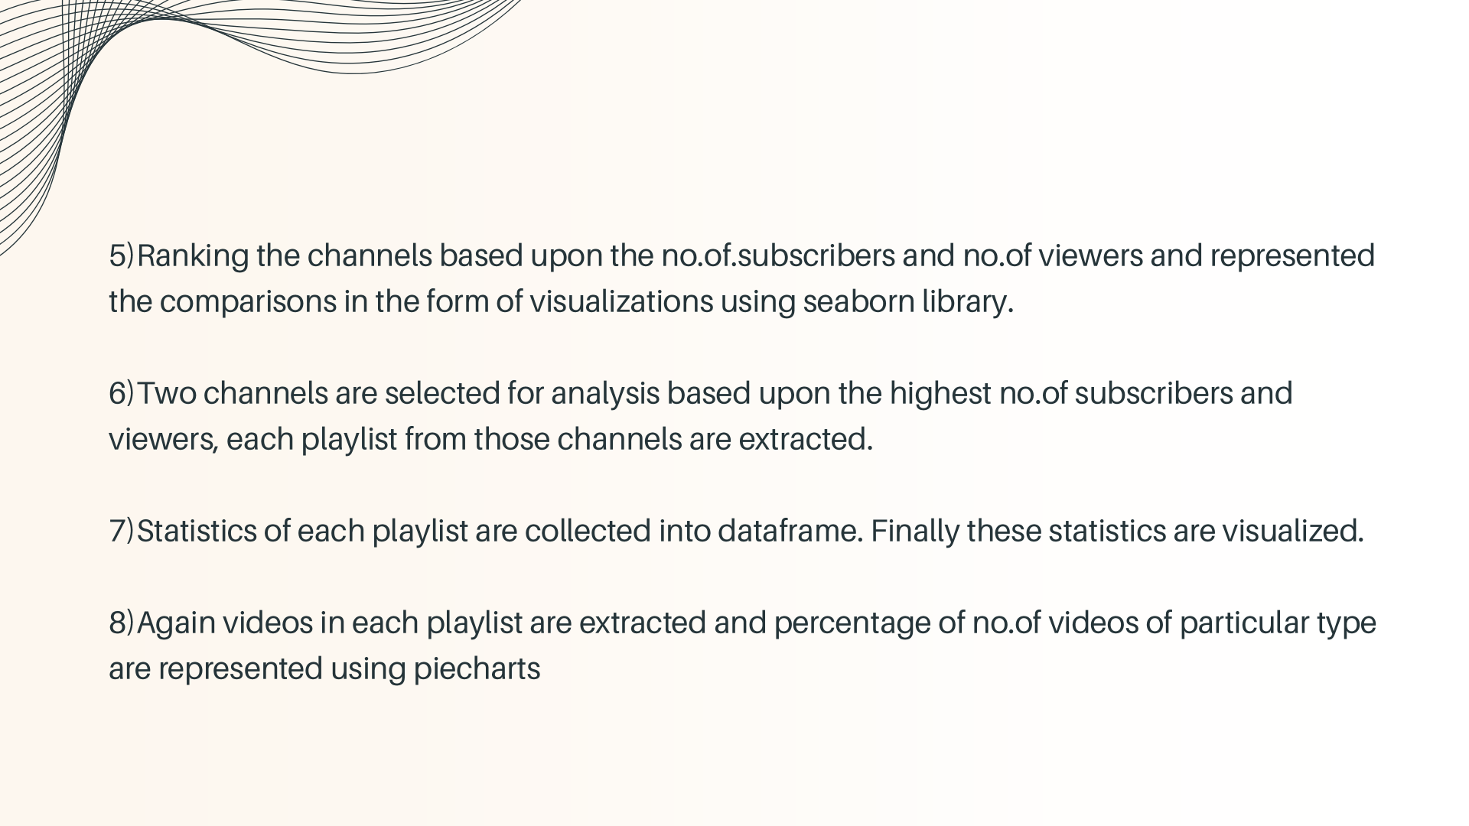

Slide 12
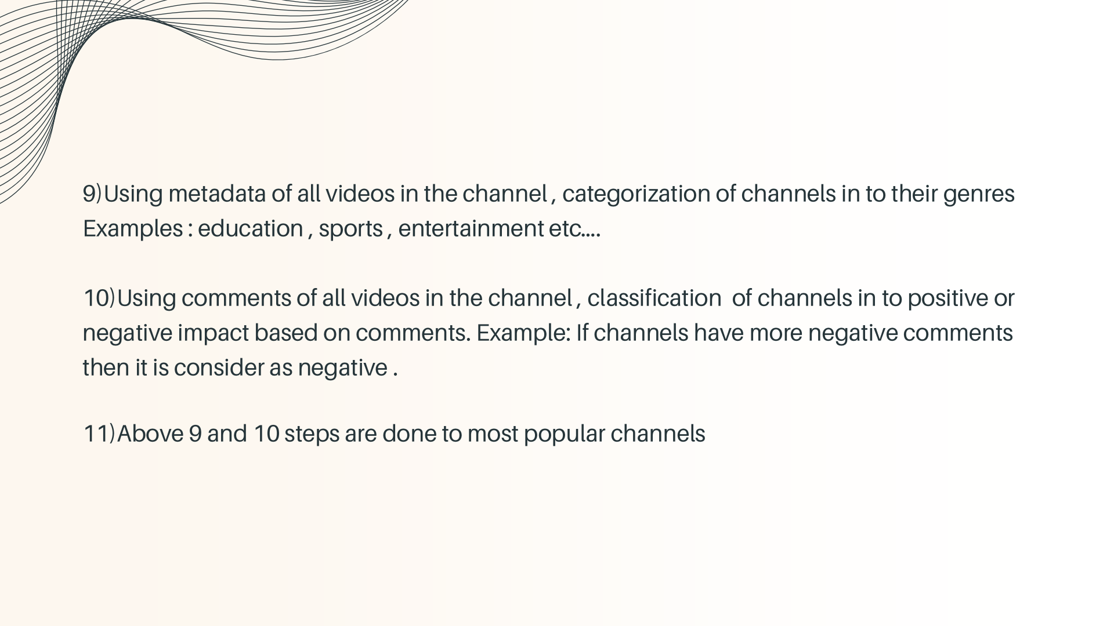

Slide 13


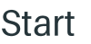





ALGORITHM:
STEP 1 :
STEP 2 :
STEP 3 :
STEP 4 :
STEP 5 :
youtube = build('youtube','v3',developerKey=api_key)

Slide 14





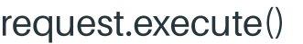

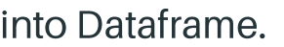



STEP 6 :
STEP 7 :
STEP 8 :
STEP 9 :
STEP 10 :

Slide 15




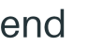
Step 11 :
Step 12 :
Step13 :

Slide 16
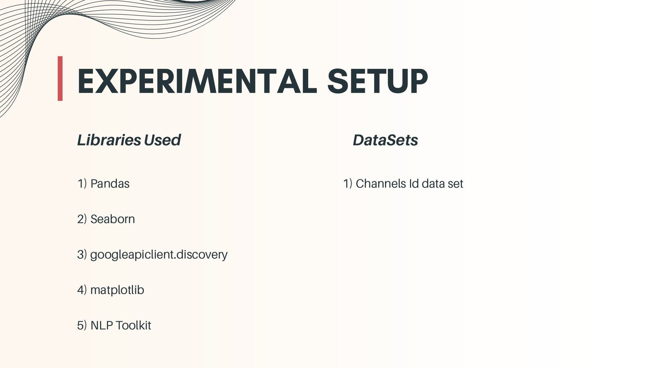

Slide 17
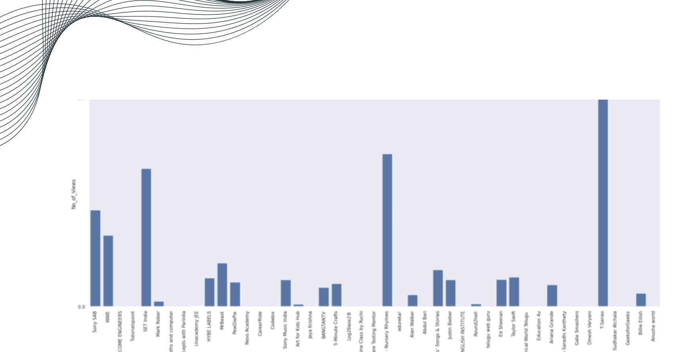
Visualization based on number views

Slide 18
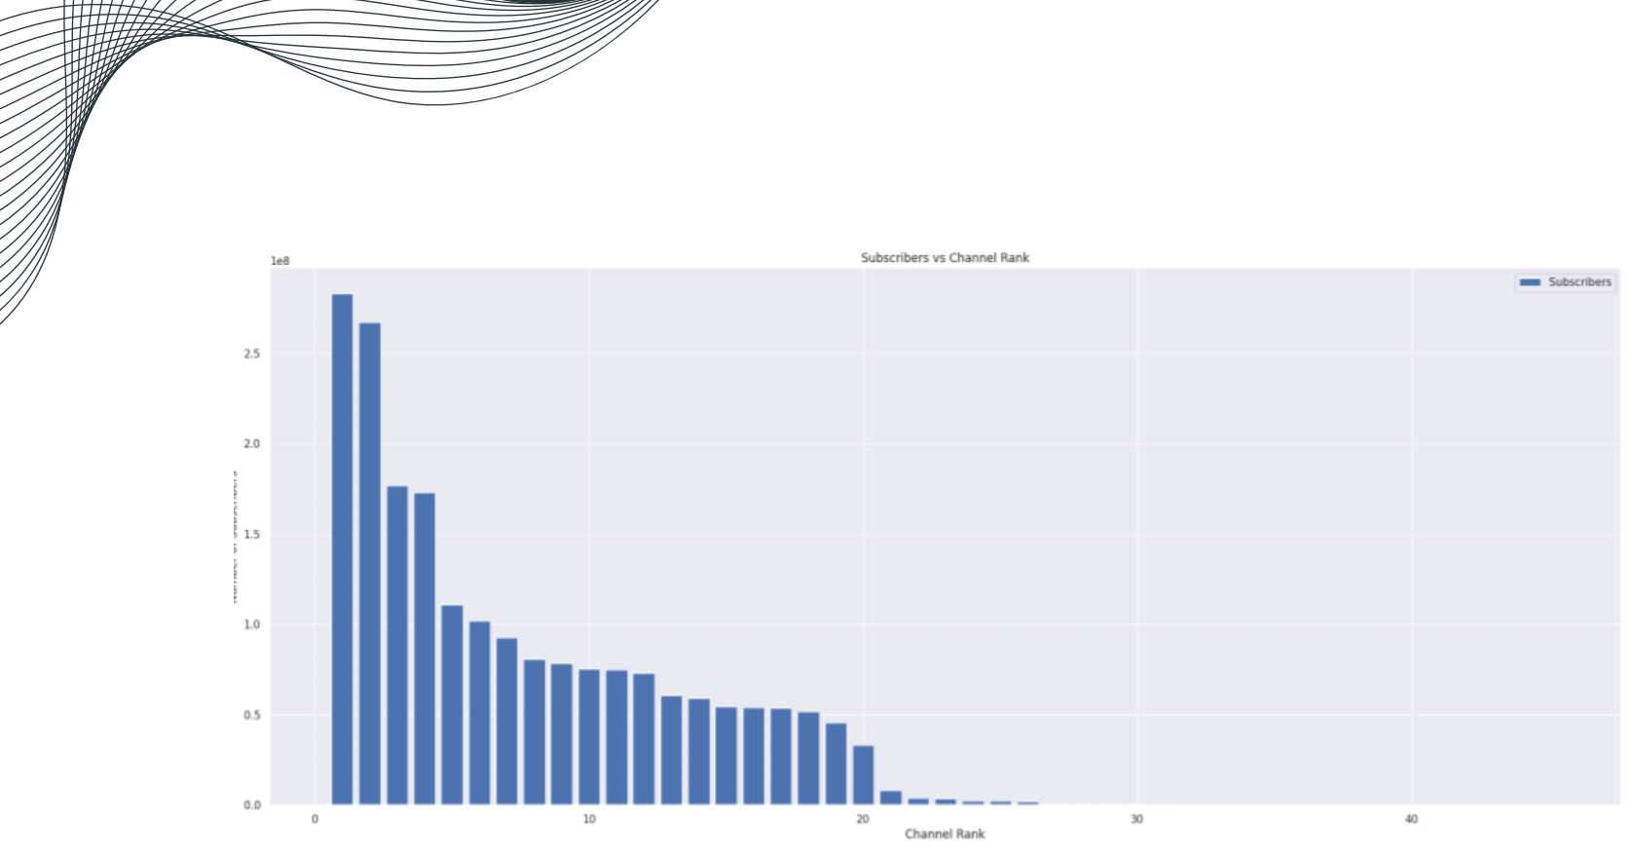
Subscribers vs channel rank

Slide 19
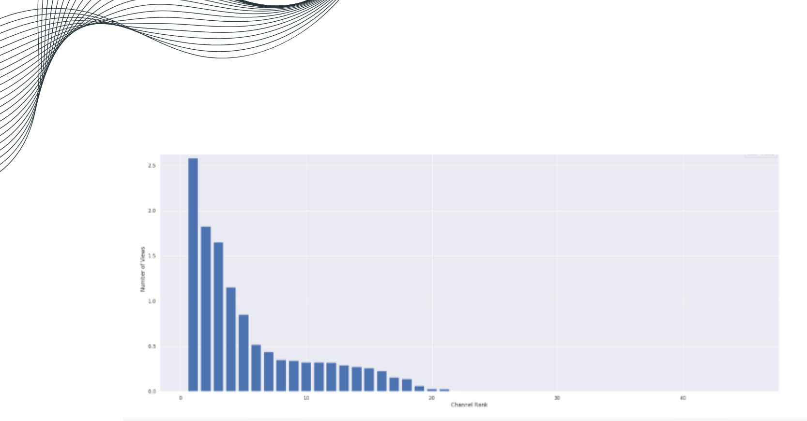
views vs channel rank

Slide 20
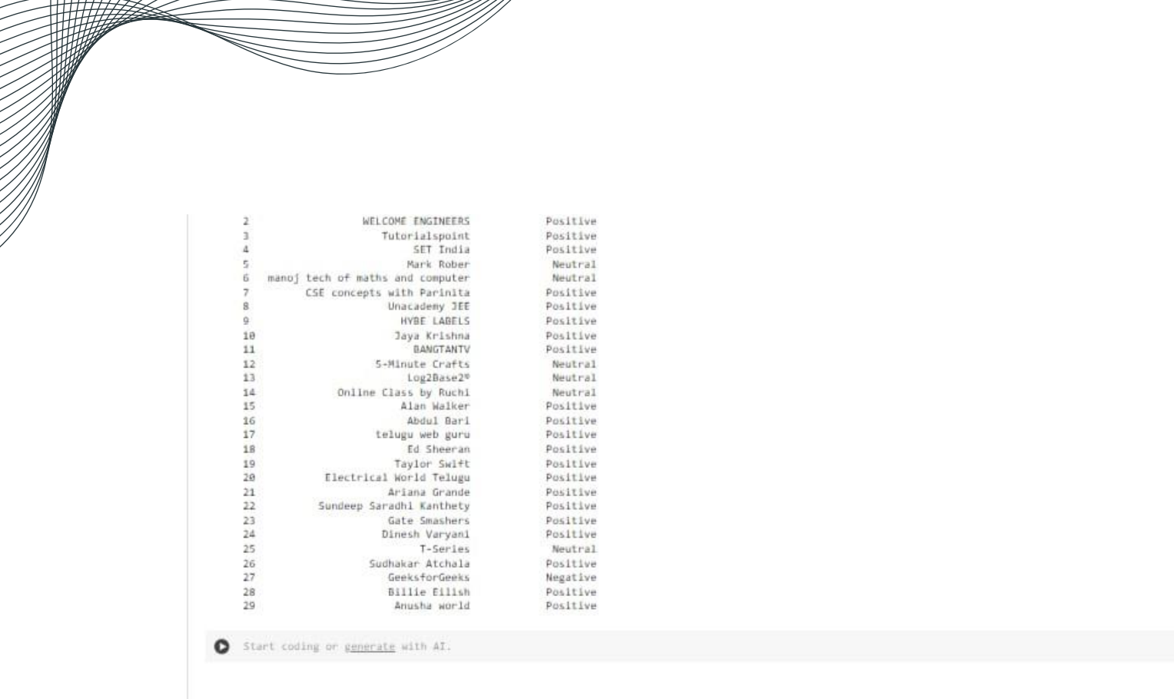
Sentiments of channels

Slide 21

1)Channel with more number
of
subscribers have more number of views .
2)In our input T-Series! channel has higher number of subscribers and got more
number of views
3) Categorized channels into genres by metadata
4) Categorized channels based on Comments using sentimental analysis .
5) this project aims to empower content creators and marketers with deeper insights into channel performance and audience sentiment.

Slide 22
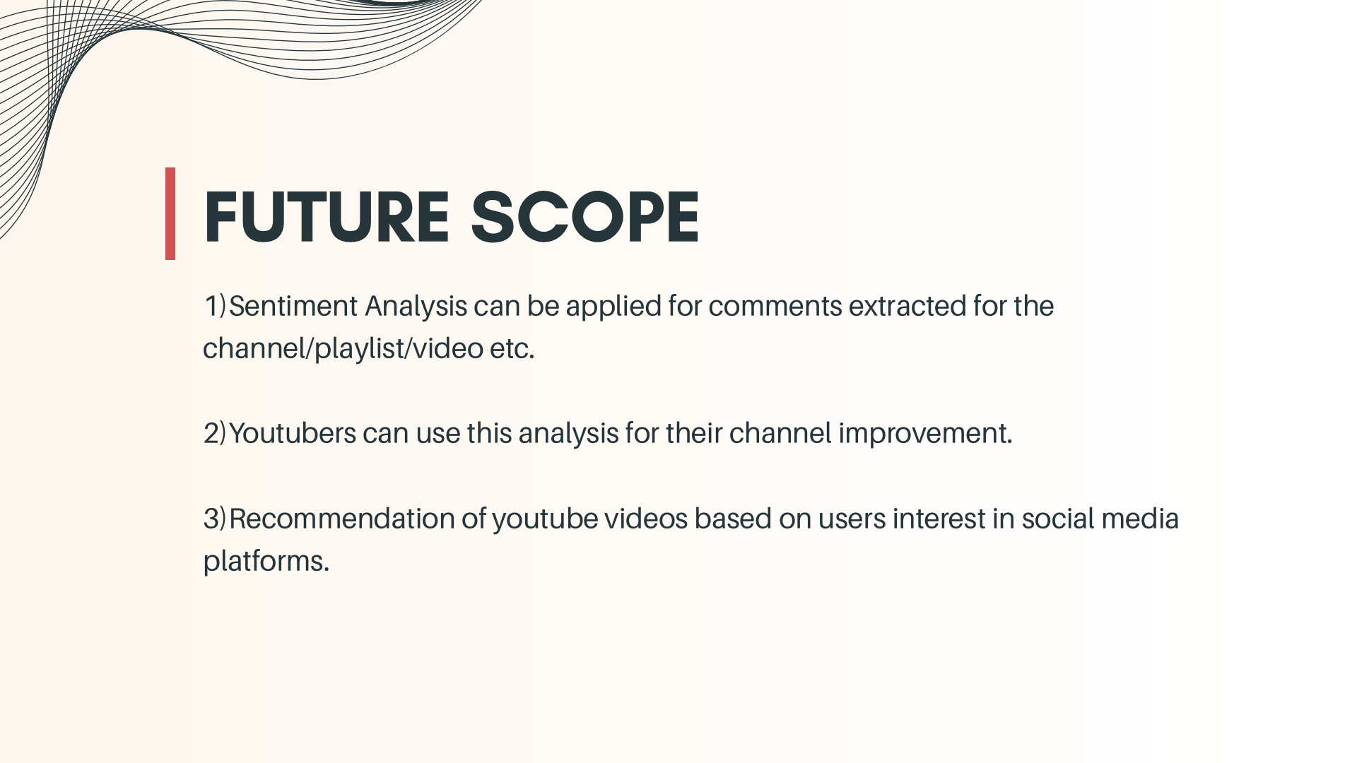

Slide 23
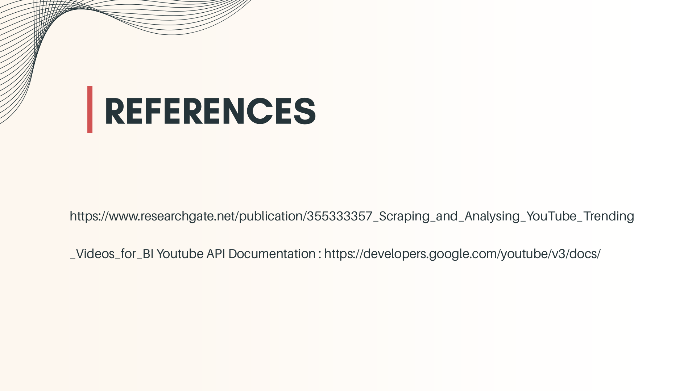

Slide 24


